Slide 1

Presented by,
Md. Mamun Ali,
ID: 181-35-274,
Department of Software Engineering,
Daffodil International University.
Machine Learning-Based Statistical Analysis for Early Stage Detection of Cervical Cancer
Supervised by,
Bikash Kumar Paul,
Research Mentor,
Department of Software Engineering,
Daffodil International University.

Slide 2
Content Outlines
Background
Motivation
Objective
Literature Review
Methodology
Result Analysis
Conclusion & Future Work
Achievement
References

Slide 3
Background
Among vaginal cancers, cervical cancer (CC) is one of the most common and causes of death for women in developing countries [1].
The American Cancer Society reported nearly 13,800 women were newly diagnosed with invasive forms of CC, and the number of deaths reached at 4290 in the United States for the year 2020 due to CC [2].
Human papilloma virus (HPV) is a major causal factor for CC, and indeed CC incidence has been dropping in countries where HPVs vaccine uptake is high [1,3].
It is possible to reduce the risk of developing CC by having screening tests and receiving a vaccine that protects against HPV infection.
Many factors are associated with CC with lower levels of association including many sexual partners, smoking, sexually transmitted infections, miscarriage prevention drug and so on [3].
It is possible to predict CC using these risk factors along with patient clinical attributes.
There are four types of clinical test to detect CC such as Biopsy, Cytology, Hinselmann, and Schiller.

Slide 4
Motivation
Although it is possible to detect CC in its early stages using regular cervical Pap smear and cytological screening, this requires high levels of resources and of engagement with patients, so that in many countries mortality remains very high.
Surgery and/or radiotherapy is used effectively for therapeutic interventions, which has many adverse effects on patients that are more severe if the CC is not caught at an early stage [4].
Unfortunately, in many developing countries under 5% of women participate in Pap smear screening programs to detect this cancer [5].
There are many reasons for lack of participation, including lack of awareness and the cost of diagnosis cost, but the consequence is that many cases of CC are detected at a late stage when therapy is more severe and survival less certain.
However, this issue can potentially be solved using the ML approaches, since ML has been found to have high predictive value for many diseases.

Slide 5
Objective
All the women throughout the world can be able to detect CC in early stage.
Diagnosis cost will be reduced.
Early stage detection of CC will increase awareness among all the women throughout the world.
Mortality rate will be reduced since early stage treatment of CC is able to cure the disease.
Doctors and clinicians will be able to decide the treatment instantly detecting CC using the proposed ML model.

Slide 6
Literature Review
Asadi, F. et al., (2020) proposed a decision tree-based ML model, which detects cervical cancer [5]. However, the observed accuracy (95.5%) of the proposed system can be improved, which is vital if surgical intervention is envisaged.
Ijaz et al., (2020) proposed a data-driven CC prediction model implementing outlier detection and over-sampling methods [6]. They used DBSCAN and iForest approach for outlier detection and removal, where SMOTETomek and SMOTE were used to balance the imbalanced dataset.
Islam, Arif- U., et al., (2019) suggested Random Forest (RF) as the best classifier for the proposed model to detect CC from clinical data [7]. However, only one single classifier is not efficient to classify four class attributes.
Elayaraja and Suganthi (2018) proposed an automatic approach for CC detection and segmentation implementing Neural Network Classifier on cervigram images witg 98.29% accuracy [8]. However, the proposed methodology did not perform well for early-stage detection of CC, which is a crucial aspect of cancer detection.

Slide 7
Literature Review Cont.
X. Qiu et al., (2017) proposed an artificial neural network model to detect CC [9]. Such neural networks are extremely complex computational methods that have powerful predictive power [10] but require very large amounts of training data.
In addition, Wu and Zhou (2017) similarly created an SVM-based classification model for CC detection [10]. Note that although an SVM approach can categorize CC data well, it has a high computational cost.
Machmud and Wijaya (2016) employed social science behavior theory to categorize CC using approaches such as Naïve Bayes (NB) and logistic regression and showed NB as best classifier with 91.67% accuracy [11]. The accuracy is not satisfactory since it is possible to generate better accuracy.
Tareef et al., (2014) employed a linear kernel support vector machine (SVM) classifier on superpixels, together with edge enhancement and adaptive thresholding [12].

Slide 8
Literature Review Cont.
Chang et al., (2013) developed a MARS-based model to predict CC, suggesting decision tree and MARS as their model’s classification algorithm [13]. In their study, the number of attributes was only 12, which is low and arguably insufficient.
Edward Kim and Xiaolei Huang (2013) proposed a data driven approach using cervigram image analysis and classification technique [14]. They employed majority vote and L-SVM method in their study and showed 73% and 75% sensitivity and 77% and 76% specificity respectively. The performance of their proposed model is not satisfactory at all since it is possible to show better performance.

Slide 9
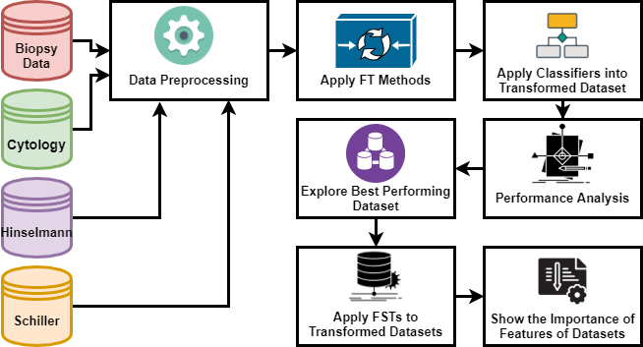
Methodology

Slide 10
Methodology Cont.
Data Collection
  Dataset is collected from Kaggle & UCI ML Repository.
  The dataset has 36 attributes along with four target attributes such as Biopsy, Cytology, Hinselmann, and Schiller.
  Among all the target attributes, 55 biopsy results were positive, 44 cytology results were positive, 35 hinselmann results were positive and 74 Schiller results were positive in the dataset will be used in this study.
  The dataset contains 858 instances.
Data Preprocessing
  Missing value handling
  Feature Engineering
  Outlier Detection & Removal
  Applied SMOTE to balance the imbalance dataset
  Dataset will be split into four sub dataset based on four target attributes.

Slide 11
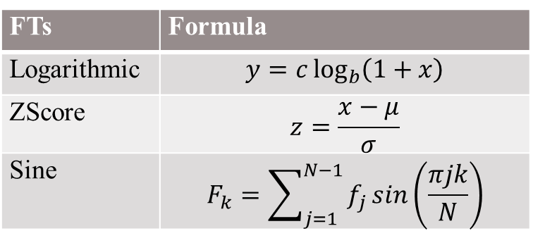
Methodology Cont.
Apply FT Methods
Apply Classifiers into Transformed Dataset
  IBk
  KStar
  SPAARC
  Random Tree
  Random Forest
FTs | Formula
Logarithmic | $$y=c\log_{b}\left(1+x\right)$$
ZScore | $$z=\frac{x−μ}{σ}$$
Sine | $$F_{k}=\sum_{j=1}^{N−1}{f_{j}\sin\left(\frac{πjk}{N}\right)}$$

Slide 12
Methodology Cont.
Instance-Based K-Nearest Neighbor (IBK)
  Applies a KNN technique that evaluates known values near an unknown data point and predicts unknown values using the measured values.
  The classifier can locate the nearest training instance (in Euclidean distance) as well as different attributes such as numeric, date, unary, binary, missing attributes when classifying a training instance [15].
  It trains and tests a model with a single instance.
  It employs cross-validation to pick the optimal value for K.
Kstar
  It is a lazy learning algorithm that seeks to split n data points into k clusters such that each data point is categorized into the closest neighbor [16].
  The K technique, known as an instance-based learner, uses the KNN approach with entropy as a distance metric [17].
  The fundamental distinction between KStar and IBk classification techniques is the definition used to describe the distance measure.

Slide 13
Methodology Cont.
SPAARC
  SPAARC stands for Split-Point And Attribute Reduced Classifier.
  It is a decision tree-based supervised machine learning algorithm.
  Consists of two elements to address computational issues in handling high dimensional datasets: (1) analyzing the numerical attribute of the tree-node split points, and (2) dynamically changing the node attribute collection space.
  The first approach involves systematically picking features with above-average knowledge gains, then using the current tree depth level to move between all features and the chosen node checking subspace.
  The second approach measures the potential split-point feature value by jumping around the different space values at equivalent widths right before the tree algorithm’s information gain calculations.
  Reduces the computational cost of the decision tree algorithm, which makes the algorithm more efficient for the classification of any kind of data.

Slide 14
Methodology Cont.
Random Forest
  It is a type of ensemble learning algorithm.
  It is derived from Decision Tree.
  Used for both of classification and regression.
  It is able to deal with higher dimensional datasets with relatively higher efficiency [18].
Random Tree
  RT is an ensemble type of supervised machine learning algorithm, which derives multiple learners.
  A decision tree is built by generating a random set of data, which is generated by exploiting the bagging method [19].
  It is upgraded version of Random forest.

Slide 15
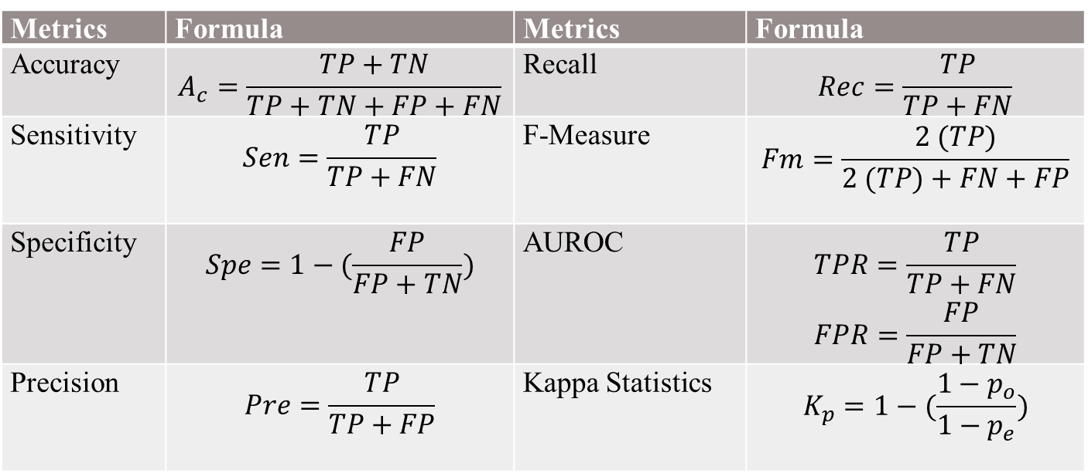
Methodology Cont.
Performance Analysis
Metrics | Formula | Metrics | Formula
Accuracy | $$A_{c}=\frac{TP+TN}{TP+TN+FP+FN}$$ | Recall | $$Rec=\frac{TP}{TP+FN}$$
Sensitivity | $$Sen=\frac{TP}{TP+FN}$$ | F-Measure | $$Fm=\frac{2 (TP)}{2 (TP)+FN+FP}$$
Specificity | $$Spe=1−(\frac{FP}{FP+TN})$$ | AUROC | $$TPR=\frac{TP}{TP+FN}$$ $$FPR=\frac{FP}{FP+TN}$$
Precision | $$Pre=\frac{TP}{TP+FP}$$ | Kappa Statistics | $$K_{p}=1−(\frac{1−p_{o}}{1−p_{e}})$$

Slide 16
Methodology Cont.
Performance Analysis
  Mean
  Median
  Maximum
Performance Comparison
  Among Classifiers
  Among FT methods for each sub dataset.
Exploring Best Performing Dataset
  Among all the transformed dataset, the best FT dataset will be selected for all the sub dataset based on performance analysis.

Slide 17
Result Analysis
Dataset | FT Methods |  | IBk | KStar | SPAARC | RT | RF
Biopsy | FT1 | Median | 98.61 | 98.95 | 98.83 | 98.61 | 98.37
 |  | Mean | 97.85 | 98.05 | 97.95 | 98.33 | 97.81
 |  | Max | 100 | 100 | 100 | 100 | 100
 | FT2 | Median | 97.96 | 98.14 | 99.07 | 98.31 | 98.72
 |  | Mean | 97.38 | 97.46 | 98.02 | 97.63 | 98.07
 |  | Max | 100 | 100 | 100 | 100 | 100
 | FT3 | Median | 98.84 | 98.84 | 99.01 | 98.61 | 98.02
 |  | Mean | 97.74 | 97.82 | 98.21 | 97.79 | 97.74
 |  | Max | 100 | 100 | 100 | 100 | 100
Cytology | FT1 | Median | 99.18 | 98.84 | 97.67 | 98.19 | 98.84
 |  | Mean | 98.24 | 97.90 | 97.46 | 97.22 | 98.19
 |  | Max | 99.88 | 99.65 | 98.84 | 99.65 | 99.88
 | FT2 | Median | 98.72 | 98.25 | 98.61 | 99.13 | 98.25
 |  | Mean | 97.90 | 97.55 | 98.11 | 98.04 | 97.90
 |  | Max | 100 | 99.65 | 99.65 | 100 | 99.88
 | FT3 | Median | 99.07 | 98.26 | 98.14 | 99.07 | 98.25
 |  | Mean | 97.99 | 97.71 | 98.04 | 98.65 | 97.95
 |  | Max | 100 | 99.65 | 100 | 100 | 100
Hinselmann | FT1 | Median | 99.01 | 99.18 | 98.37 | 98.37 | 99.36
 |  | Mean | 98.40 | 98.38 | 98.37 | 97.93 | 99.16
 |  | Max | 99.54 | 99.54 | 99.54 | 99.54 | 99.54
 | FT2 | Median | 98.72 | 98.84 | 97.961 | 98.37 | 99.30
 |  | Mean | 97.95 | 98.02 | 97.99 | 97.86 | 99.07
 |  | Max | 99.54 | 99.54 | 99.30 | 99.54 | 99.54
 | FT3 | Median | 98.95 | 99.18 | 98.19 | 98.78 | 99.36
 |  | Mean | 98.15 | 98.39 | 98.08 | 98.08 | 99.16
 |  | Max | 99.54 | 99.54 | 99.30 | 99.54 | 99.54
Schiller | FT1 | Median | 98.14 | 98.02 | 98.14 | 97.90 | 98.60
 |  | Mean | 97.49 | 96.66 | 96.94 | 97.69 | 98.42
 |  | Max | 99.77 | 99.07 | 100 | 100 | 100
 | FT2 | Median | 99.07 | 98.72 | 98.83 | 98.60 | 98.60
 |  | Mean | 98.58 | 98.35 | 97.65 | 97.72 | 97.62
 |  | Max | 100 | 100 | 100 | 100 | 100
 | FT3 | Median | 98.49 | 98.25 | 98.95 | 98.31 | 98.72
 |  | Mean | 98.50 | 97.09 | 97.88 | 97.77 | 97.90
 |  | Max | 100 | 100 | 100 | 100 | 100

Slide 18
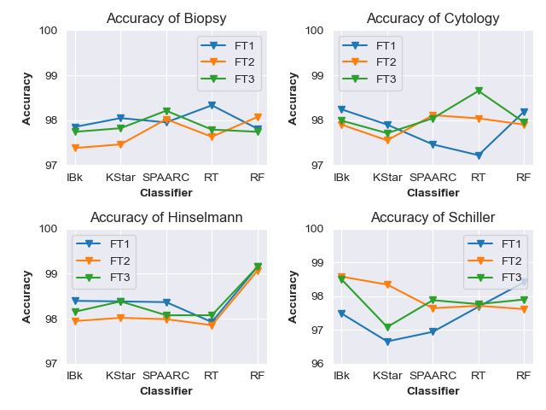
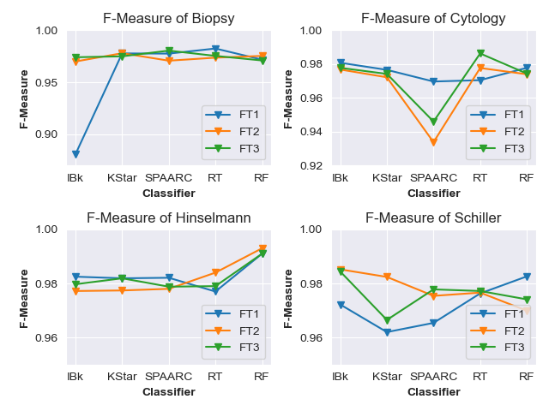
Result Analysis Cont.

Slide 19
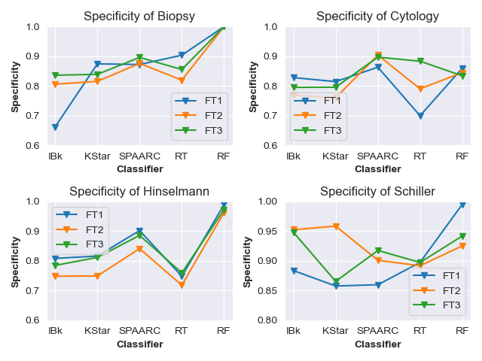
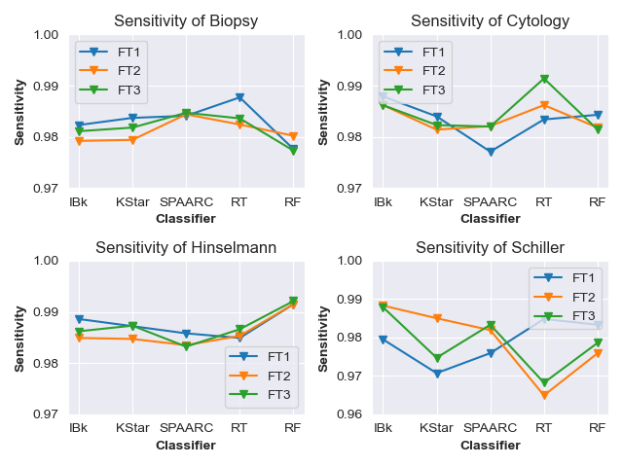
Result Analysis Cont.

Slide 20
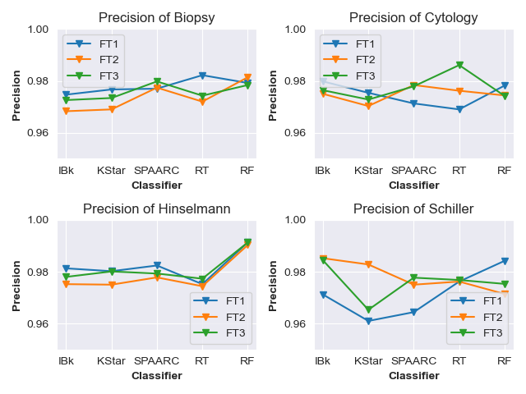
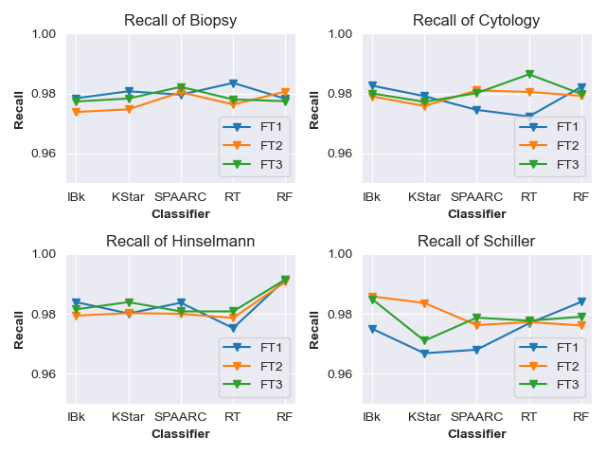
Result Analysis Cont.

Slide 21
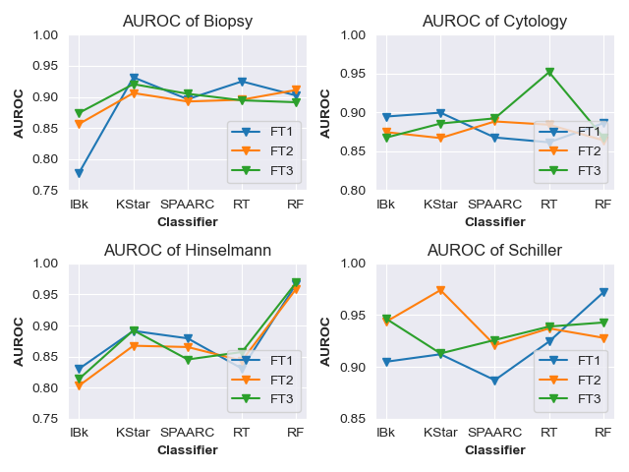
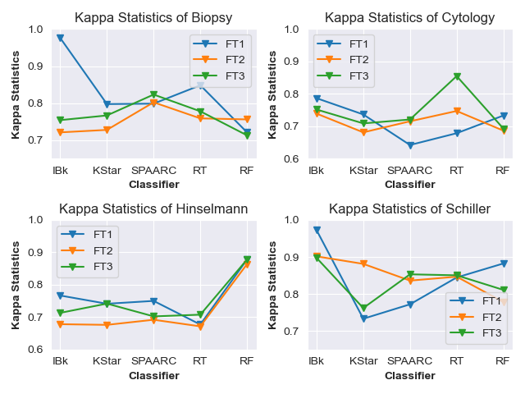
Result Analysis Cont.

Slide 22
Conclusion & Future Work
Overall, the findings and the proposed model’s characteristics are as follows:
  Best Performing FT Methods for Biopsy FT1 (Logarithmic), for Cytology FT3 (Sine function), for Hinselmann FT1(Logarithmic) and FT3 (Sine function), for Schiller (IBk)
  The best performing classifier for Biopsy and Cytology is RT, for Hinselmann and Schiller RF and IBk respectively.
  Increasing awareness among women about CC.
  Reducing screening test cost.
  Reducing death toll due to CC.
Future Work
  The accuracy of the proposed work can be upgraded by applying a large Dataset.
  Furthermore, others algorithms can be applied for a better understanding of the estimated model.

Slide 23
Achievement
Manuscript Title: Machine Learning-Based Statistical Analysis for Early Stage Detection of Cervical Cancer.
Journal Name: Computers in Biology & Medicine
Quartile: Q1
Impact Factor: 4.589
DOI: https://doi.org/10.1016/j.compbiomed.2021.104985

Slide 24
Reference
Olusola, P., Banerjee, H.N., Philley, J.V. and Dasgupta, S., 2019. Human papilloma virus-associated cervical cancer and health disparities. Cells, 8(6), p.622.
https://www.cancer.org/cancer/cervical-cancer/about/key-statistics.html [Accessed on 28 February, 2021]
Burchell, A.N., Winer, R.L., de Sanjosé, S. and Franco, E.L., 2006. Epidemiology and transmission dynamics of genital HPV infection. Vaccine, 24, pp.S52-S61.
Mohaghegh, F. and Ahmadlou, M., 2015. A Study of the Prevalence of Cervical Cancer among Married Wemon in Arak, 2013. Journal of Arak university of Medical Sciences, 18(4), pp.65-70.
Asadi, F., Salehnasab, C. and Ajori, L., 2020. Supervised Algorithms of Machine Learning for the Prediction of Cervical Cancer. Journal of Biomedical Physics and Engineering.
Ijaz, M.F., Attique, M. and Son, Y., 2020. Data-driven cervical cancer prediction model with outlier detection and over-sampling methods. Sensors, 20(10), p.2809.
Islam, A.-. U.-., Ripon, S. H. and Bhuiyan, N. Q. (2020) “Cervical Cancer Risk Factors: Classification and Mining Associations”, APTIKOM Journal on Computer Science and Information Technologies, 4(1), pp. 8-18. doi: 10.34306/csit.v4i1.85.
Elayaraja, P. and Suganthi, M., 2018. Automatic approach for cervical cancer detection and segmentation using neural network classifier. Asian Pacific Journal of Cancer Prevention, 19(12), p.3571.
Qiu, X., Tao, N., Tan, Y. and Wu, X., 2007. Constructing of the risk classification model of cervical cancer by artificial neural network. Expert Systems with Applications, 32(4), pp.1094-1099.
Wu, W. and Zhou, H., 2017. Data-driven diagnosis of cervical cancer with support vector machine-based approaches. IEEE Access, 5, pp.25189-25195.
Machmud, R. and Wijaya, A., 2016. Behavior determinant based cervical cancer early detection with machine learning algorithm. Advanced Science Letters, 22(10), pp.3120-3123.

Slide 25
References
Tareef, A., Song, Y., Cai, W., Feng, D.D. and Chen, M., 2014. Automated three-stage nucleus and cytoplasm segmentation of overlapping cells. 13th International Conference on Control, Automation, Robotics & Vision, Marina Bay Sands, Singapore (ICARCV 2014, IEEE, pp. 865-870).
Zhang, Y., Wang, J. and Luo, X., 2015. Probabilistic wind power forecasting based on logarithmic transformation and boundary kernel. Energy conversion and management, 96, pp.440-451.
Akter, T., Satu, M.S., Khan, M.I., Ali, M.H., Uddin, S., Lio, P., Quinn, J.M. and Moni, M.A., 2019. Machine learning-based models for early stage detection of autism spectrum disorders. IEEE Access, 7, pp.166509-166527.
Singh, P., Singh, S. and Pandi-Jain, G.S., 2018. Effective heart disease prediction system using data mining techniques. International journal of nanomedicine, 13(T-NANO 2014 Abstracts), p.121.
Chang, C.C., Cheng, S.L., Lu, C.J. and Liao, K.H., 2013. Prediction of recurrence in patients with cervical cancer using MARS and classification. International Journal of Machine Learning and Computing, 3(1), p.75.
Kim E., Huang X., 2013. A Data Driven Approach to Cervigram Image Analysis and Classification. In: Celebi M., Schaefer G. (Eds) Color Medical Image Analysis. Lecture Notes in Computational Vision and Biomechanics, Springer, Dordrecht.
Mohan, S., Thirumalai, C. and Srivastava, G., 2019. Effective heart disease prediction using hybrid machine learning techniques. IEEE Access, 7, pp.81542-81554.
Thabtah, F. and Peebles, D., 2020. A new machine learning model based on induction of rules for autism detection. Health informatics journal, 26(1), pp.264-286.

Slide 26
Do you have
any question?

Slide 27
Thank You So Much

